Slide 1
Airplane
Crash
Analysis
on
Tableau

Slide 2
What is this presentation about?
As a part of the internship at MENTORNESS, we analyzed airplane crashes and fatalities spanning from 1980 to 2023.
The prime objective was to leverage Tableau for interactive visualizations and in-depth insights to understand patterns, and trends in aviation incidents. The analysis aims to provide stakeholders with valuable information for contributing factors enhancing aviation safety and mitigating risks.
In the following slides, we will explain the visuals that we used to analyze the data using Tableau.

Slide 3
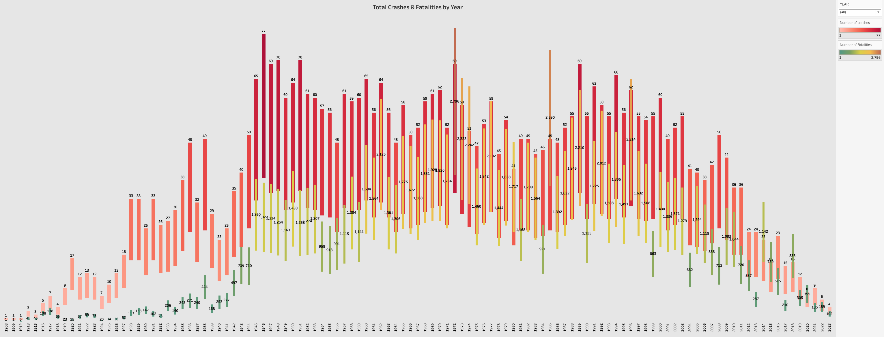
TEMPORAL ANALYSIS
We tired to understand the year wise distribution of number of crashes and the number of fatalities using the waterfall charts.
Highest number of crashes in the year of 1946.
Highest number of fatalities in the year of 1972.

Slide 4
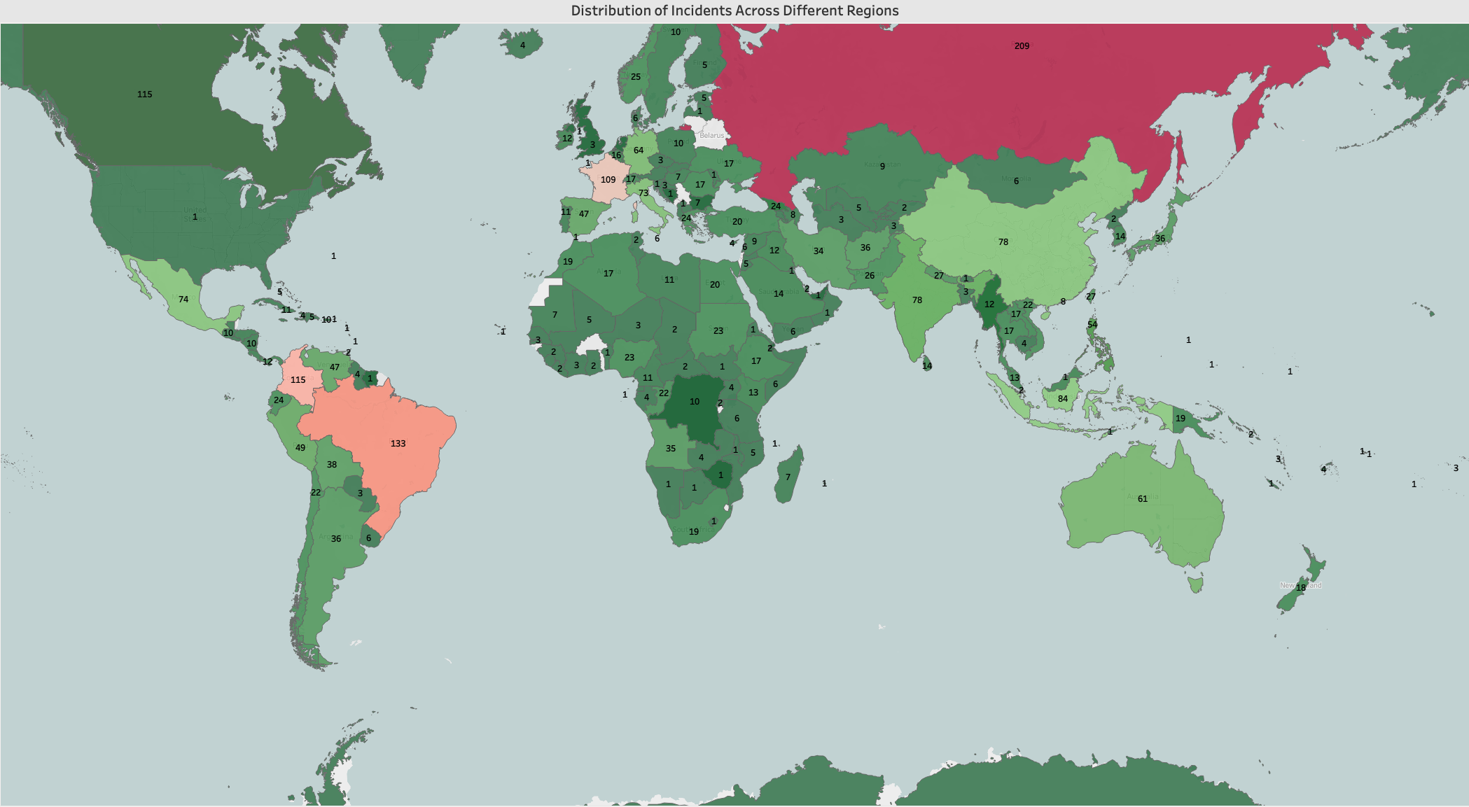
GEOSPATIAL ANALYSIS
This map shows the region-wise number of crashes from 1980 to 2023. We used color coding to represent the number of crashes where dark red indicates the most accident-prone region.
Russia has faced the highest number of crashes
Brazil is the second highest accident-prone region having 133 incidents until 2023.

Slide 5
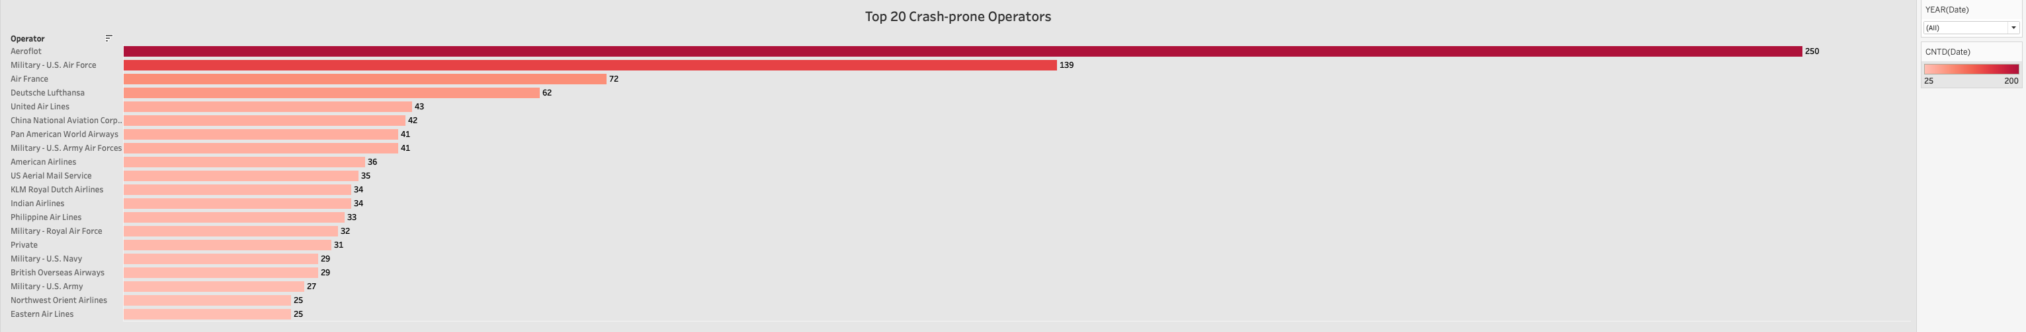
OPERATOR PERFORMANCE
We identified top 20 crash-prone operators till 2023 using horizontal bar chart. The operator Aeroflot is responsible for the highest crash incidents till 2023, followed by U.S. Military Air Force with 139 incidents.

Slide 6
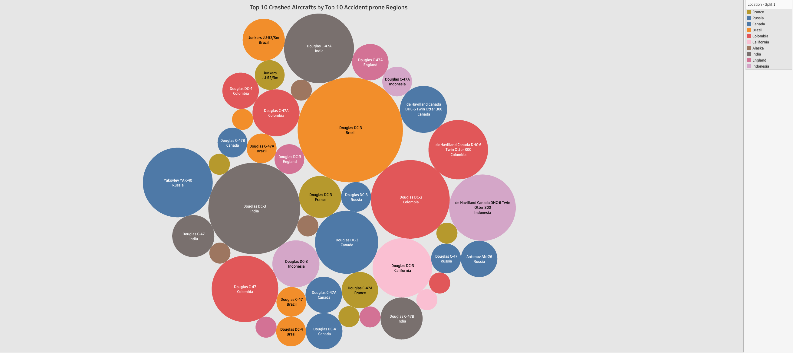
AIRCRAFT ANALYSIS
This bubble chart represents the top 10 crashed aircraft by the top 10 accident-prone regions. The color coding represents different regions where as the size of each bubble indicates the number of crashes.
In Brazil, Douglas DC-3 aircraft registered the highest number of crash incidents (25).
There are total 14 registered crash incidents for Douglas DC-3 aircraft which is the highest amoung others in Colombia
In India, Douglas DC-3 has also registered the highest number of incidents, 19 crash cases.

Slide 7
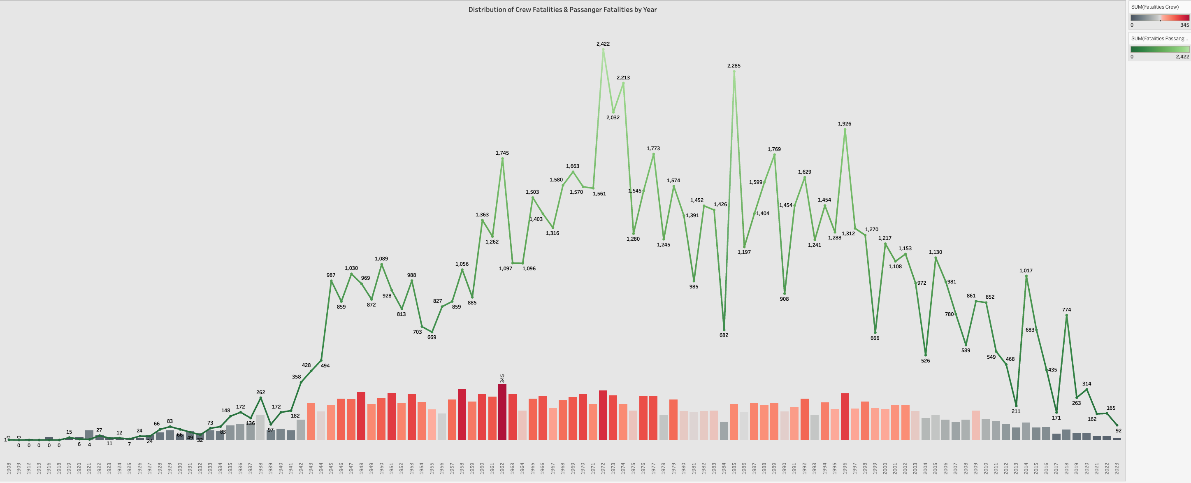
FATALITY ANALYSIS
We visualized the distribution of total crew fatalities using a vertical bar chart and total passenger fatalities using a line chart over different years.
In 1972, there was a highest number of passenger fatalities observed which is 2,422.
In 1962, the total number of crew fatalities was maximum as compared to the other years (345).
In 1921, the total number of crew fatalities(27) was higher than the passenger (4) fatalities

Slide 8
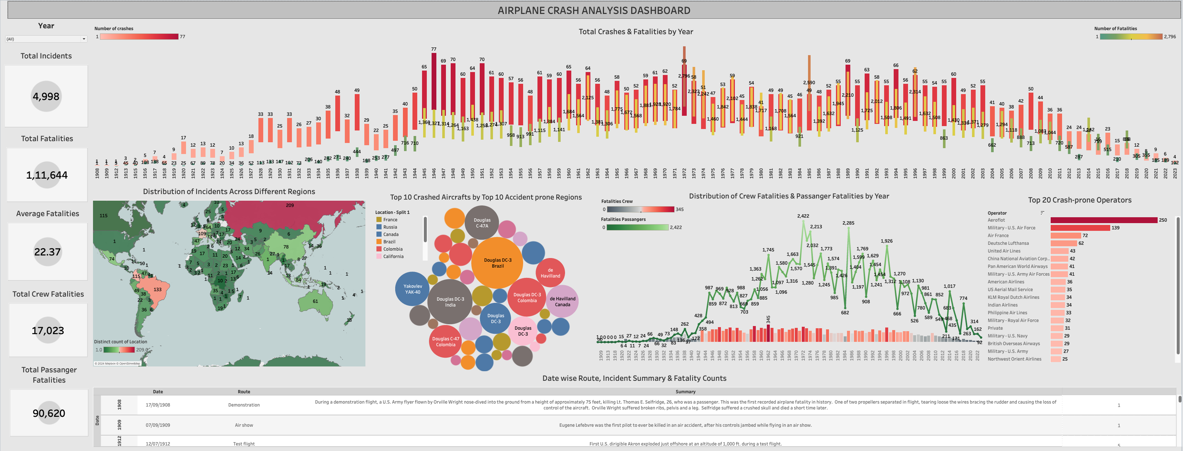
COMPLETE DASHBOARD ON AIRPLANE CRASH ANALYSIS

Slide 9
THANKS

